Slide 1
CMSC 27200 Project Presentation
[noname]

Slide 2
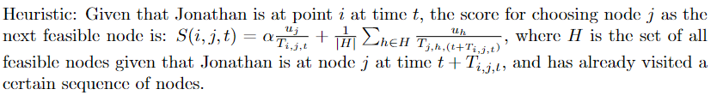
What your code does
Greedy + 2 forms of brute force: Greedier(n, α, β, m)
Part 1: Feasible brute force for the first n nodes
Part 2: Feasible greedy, select top m nodes each time
Heuristic is based on utility/time
-
-

Slide 3
How well you think it works
Greedier(n, α, β, m)
n: Good with caveats
Worked for inputs with lots of infeasible nodes. Could easily do n = 1, 2, 3, 4.
Way too slow for inputs with few start/end time restrictions, especially large inputs. Could only do n = 1 or 2 max. Partial results were bad as well.
Greedy(n) alone beat the baseline.
α, β: Marginal improvement, not that significant.
Didn’t have time to try out many different combinations anyway
m: Good in general
Worked much better for the inputs that couldn’t run under large n.
The final improvement that moved us up the leaderboards to beat admin’s score

Slide 4
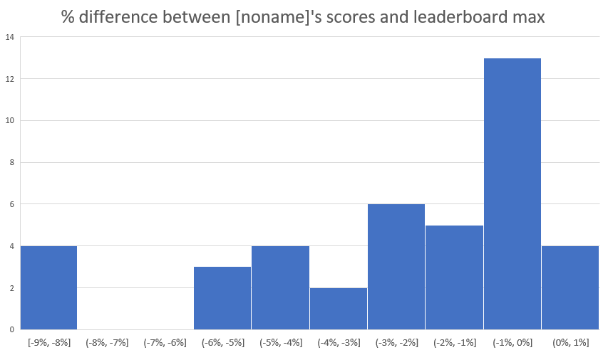
How well you think it works

Slide 5
Why you settled on the approach you did
Pull factors:
Relatively simple
Able to quickly modify heuristic / algorithm in response to challenging inputs
Able to get better results with time, via brute force
Push factors:
Genetic algorithm failed
No idea how to do DP or LP

Slide 6
What you would do if you had more time
Focus on cutting the time required for Greedier(n, α, β, m) :
Actual implementation had n at least 1, but it should be 0. On hindsight, implementing m was more than sufficient to mitigate the benefits of n.
New parameter k: Only get top m nodes in greedy for up to the first k nodes in any sequence
Reduce inefficiencies in the code to speed up runtime, e.g. if β = 0, then the extra calculation should be skipped, not executed then thrown away.
Try out many more values of α, β.

